Slide 1
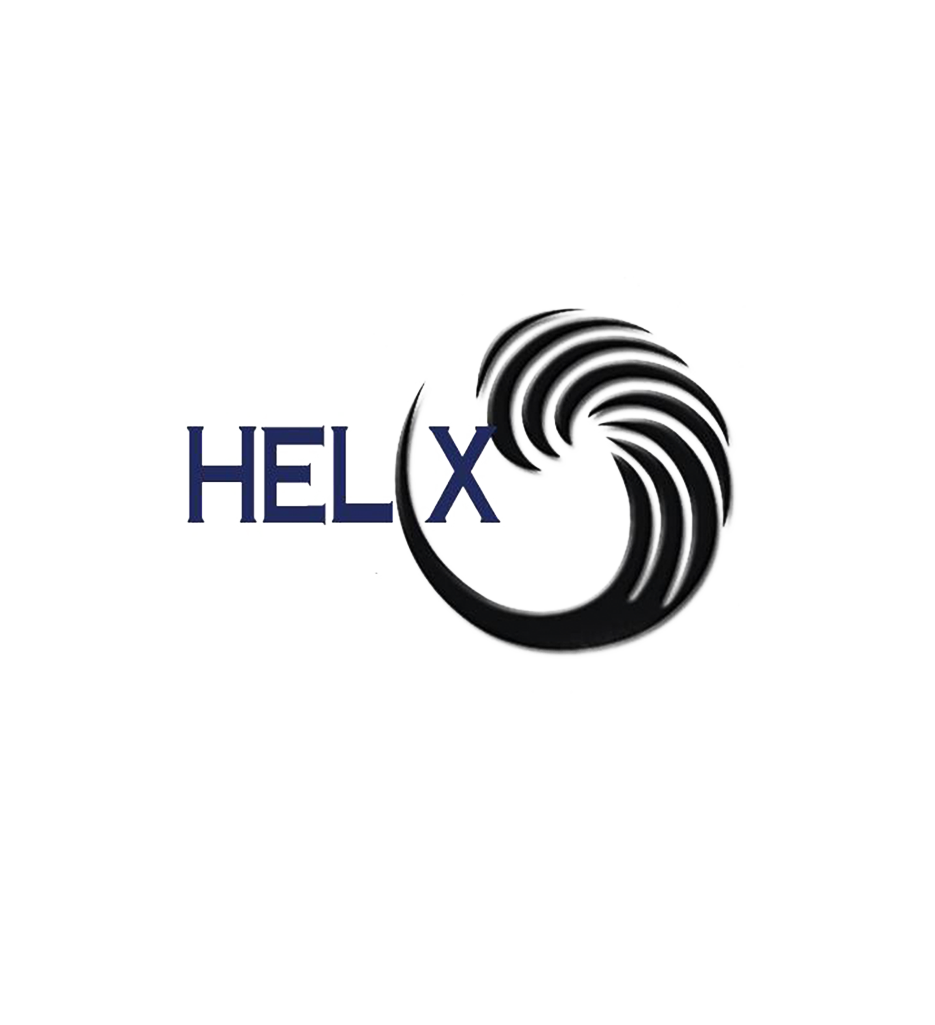
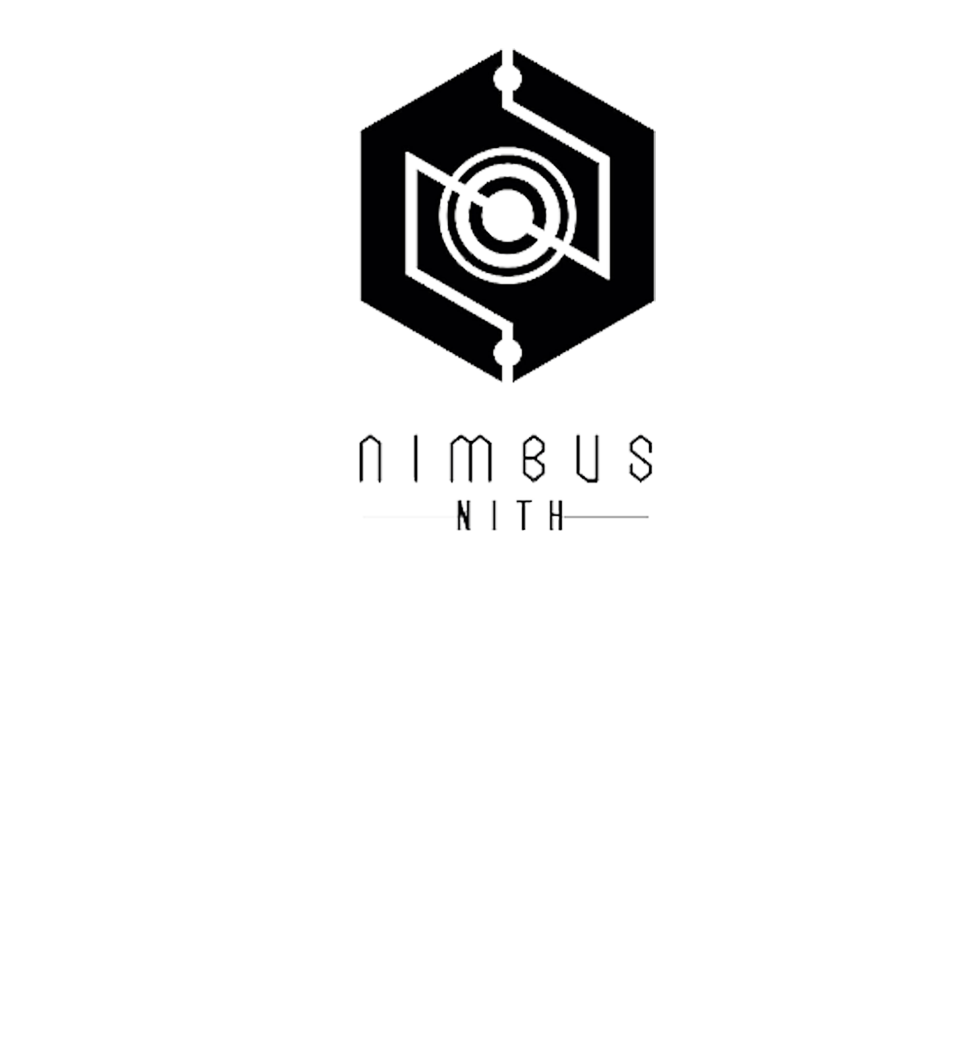
AUREUS: AURORA RENEWABLE ENERGY & UV SEQUESTRATION
Civil Engineering Department
C-Helix Exhibition
Proposed By:- Dashrath prajapat constructed by:- dashrath prajapat
atul patel

Slide 2
Objective:- The measure objective of this technology is to use the UV light from sunlight and decrease the harm of UV light by converting it into usable energy form. Uses technology synthesized from upcycled crop waste to absorb stray UV light from sunlight and convert it to clean renewable electricity. To fulfill the losses of crop spoils of farmers , creating a better environment for people outdoors and advantage in UV sequestration.
Abstract :-
The AUREUS system is an evolution for walls/windows, and uses technology synthesized from upcycled crop waste to absorb stray UV light from sunlight and convert it to clean renewable electricity . the composition ,uses for the AUREUS system comprising photo-luminescent elements that absorb UV radiation and emit longer wavelength non ultraviolet radiation .photoluminescent elements are dispersed on or in a material that may be a transparent film. IT champions the issues of UV sequestration, better access to solar energy for climate change mitigation and supporting the local agriculture industry hit by calamities by upcycling crops that would otherwise be considered wastes thus, mitigating farmer loss and provides better environment .

Slide 3
Solar panel is used normally for photo-voltaic module. A PV module is an assembly of photo-voltaic cells mounted in a framework for installation. In Photo-voltaic cells semiconductor is used which convert mostly visible range of sunlight into electrical energy and generate direct current electricity but it is unable to converts other ranges of radiation like :-ultra violet radiation etc. And by using this AUREUS devices with solar technology we can also convert UV light to visible range radiation to electrical energy.
Existing technology:-

Slide 4
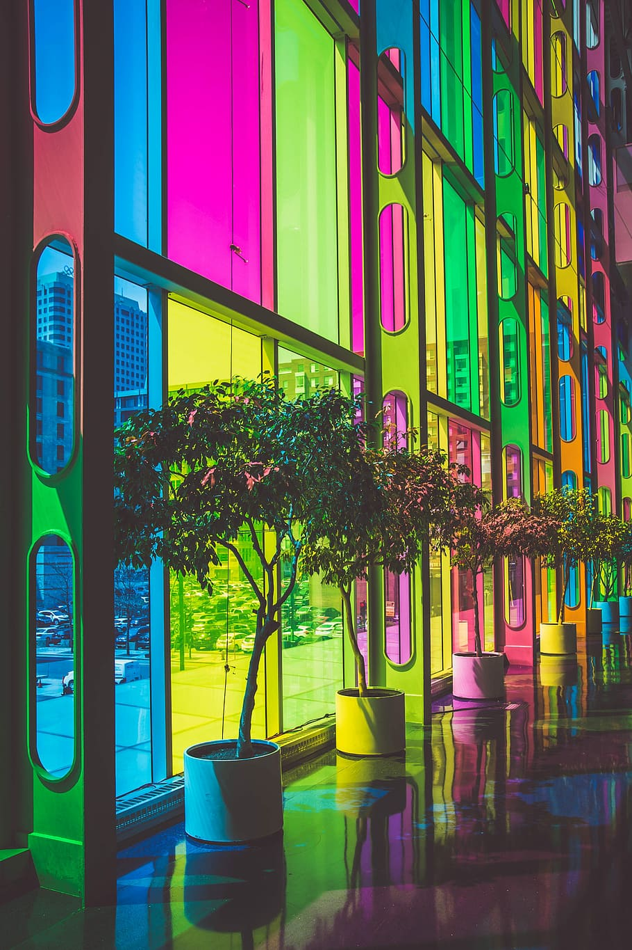
Present Applications:- The AUREUS system is an evolution for walls/windows, in AUREUS tech we form a substrate comprising photoluminescent elements that absorb UV radiation . In certain aspects the photoluminescent elements are dispersed on or in a material form transparent film which is favourable for windows by cost and for environment .
****Montreal Convention Centre :conversion to AUREUS tech will unlock additional 18 kW power asset.

Slide 5
Execution:-
Astralis solar walls & Borealis solar window:-
Both AUREUS devices use the same technology derived from the phenomena that governs the beautiful Northern and Southern lights. High energy particles are absorbed by luminescent particles and degraded to low energy state as visible light. Similar type of luminescent particle (derivable from certain fruits and vegetables) were suspended in a resin substrate and is used as the core technology on both devices. When hit by UV light, the particles absorb and re-emit visible light along the edges due to internal reflectance. PV cells are placed along the edges to capture the visible light emitted. The captured visible light are then converted to DC electricity. Regulating circuits will process the voltage output to allow battery charging, storage, or direct utilization of electricity.
Solar Farms are built horizontally and never vertically, until now. Since AUREUS captures UV, it can produce electricity even when not facing the sun. Buildings clad on all sides with AUREUS become vertical solar farms.

Slide 6

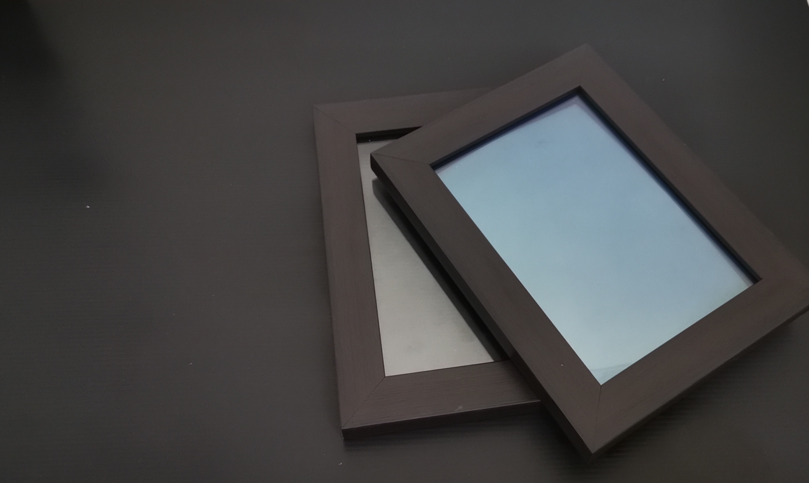
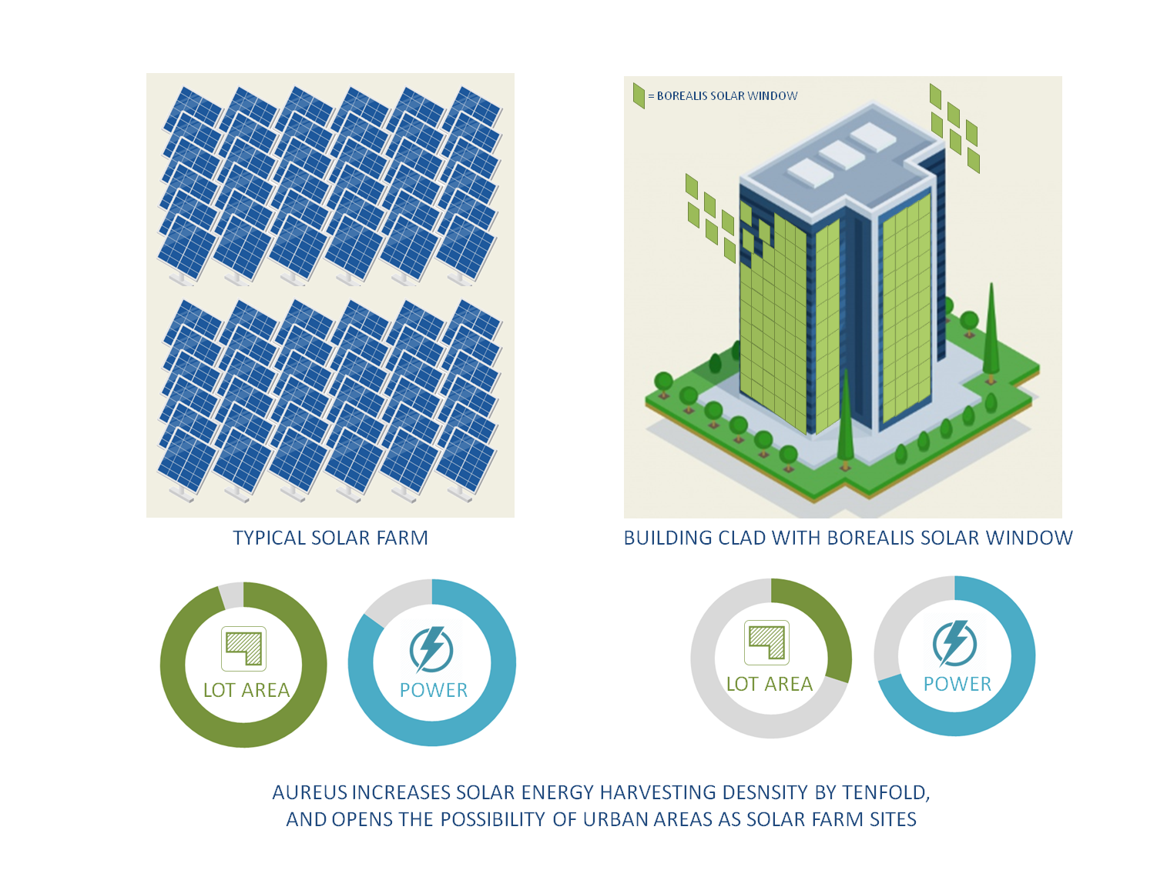
****Miniaturized Borealis solar window can power a small DC motor
****Montreal Convention Centre :conversion to AUREUS tech will unlock additional 18 kW power asset.
****AUREUS increases solar energy harvesting density by tenfold ,
And opens the possibility of urban areas as solar farm sites.

Slide 7
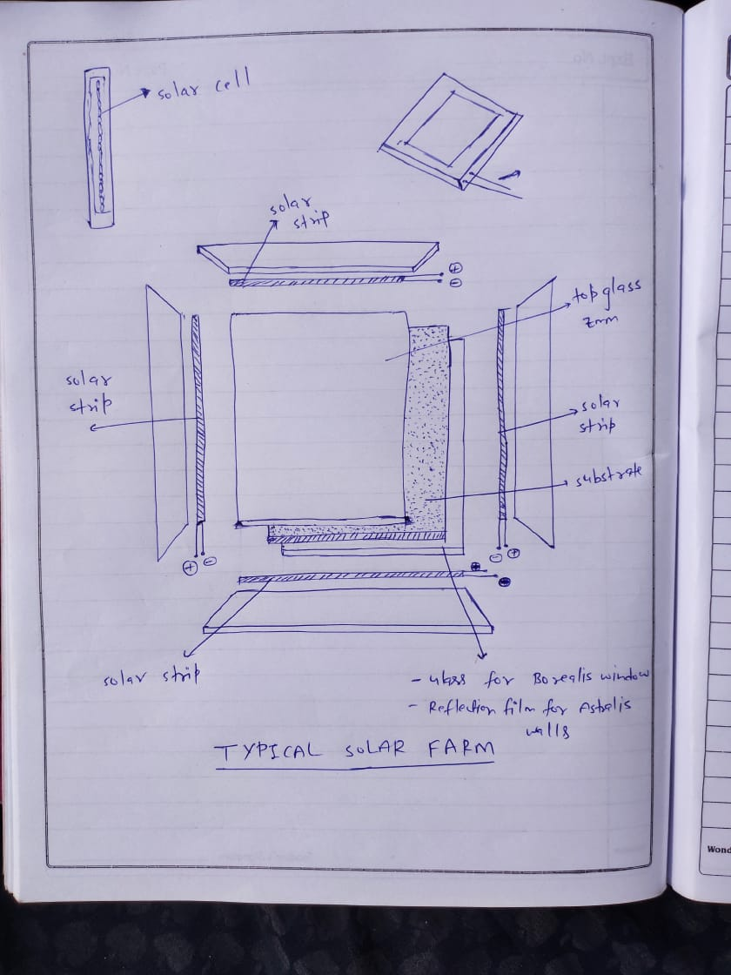
****This the prototype of this project.
AUREUS cladding can be applied to windows and walls , will increase additional power asset .
**********Composition of substances used in the formation of mixture of AUREUS CLAD:-
Resin A= 55-65%
Resin B = 30-35%
Dye = 7 - 9% (Lycopersicum Esculentum)

Slide 8
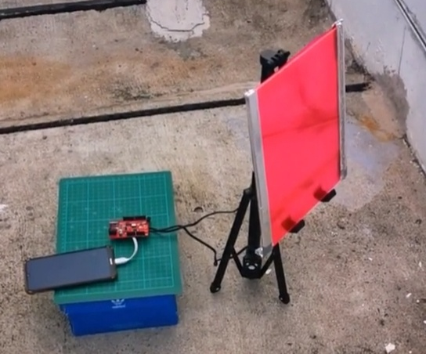
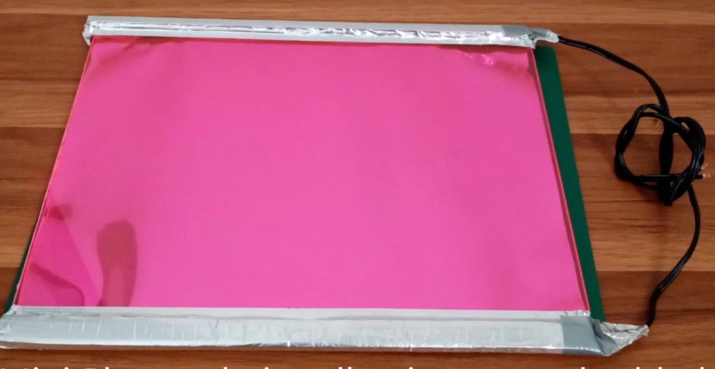
Efficiency:- Every AUREUS substrate having different efficiency because every substrate having different composition .By using chemical ones like : CdTe , CdSe , PbS quantum dots (QD) , substrate can absorb upto 95% UV light and here we are using crop waste like : dye extracted from the fruits and vegetables , have the luminescent particles can absorb upto 80% UV light . efficiency of the photovoltaic strips that we are using for Demo is 25% approx.
A 3-by-2-foot panel can produce 10,000 mAh electrical power in a day approximately.
****Proof of testing: Performance of the substrate with extracted dye from Tomato (Lycopersicum Esculentum)
****Resin with luminescent dye extracted from tomato gave the substrate a reddish hue.

Slide 9
Cost Analysis
S. No. | COMPONENTS | QUANTITY | SPECIFICATIONS | COST (RS.)
1 | Resins A&B | 250gm per | Transparent Epoxy Resins | 500
2 | Photovoltaic cell strips | 4 |  | 1000
3 | Voltage regulator | 1 | Microcontroller | 1050
4 | DC motor | 1 | 3v | 200
5 | Transparent silicone rubber sheet | 2 |  | 800
 |  |  | Total cost = | 3550

Slide 10
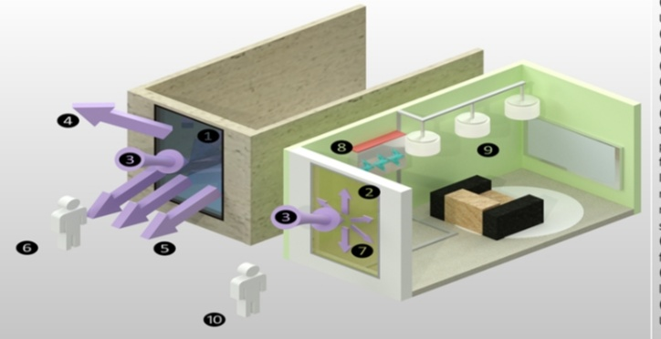
Benefits:-
Use of AUREUS tech will unlock additional power asset.
It is very lowcost tech cause of upcycled crop waste use as absorbent also having high absorbing power upto 80%.
AUREUS can function even when not directly facing the sun.
****Advantage in UV sequestration for people outdoors
UV rays is absorbed and redirected to the edges of the fluorescent polymer plate as visible light as principle of fluorescence. The visible light emitted is then converted by photovoltaic modules into electricity .
*This minimalizes the reflect of UV rays unto streets pedestrians.
*electricity can be stored for later use.

Slide 11
Merits:-
By using upcycled crop waste as UV light absorbent is economically beneficial for farmers and local agriculture industry.
Use of AUREUS tech will unlock additional power asset(PV solar panels are only absorb visible range of sunlight, but by using it UV convert to visible range and also used for production of electrical energy .)
AUREUS can function even when not directly facing the sun, it can rely on UV scattering through clouds and by UV light bouncing along walls, pavements, other buildings. This will enable the construction of a Vertical Solar Farm even with a small lot area.
Advantage in UV sequestration and creating a better environment for people outdoors.
It is very lowcost tech cause of upcycled crop waste use as absorbent.
Demerits:-
Additional research will be done on extracting needed luminescent particles to allow 100% (from the current 80%) sourcing of dyes from fruits and vegetables instead of chemical ones.

Slide 12
conclusion:-
Conversion to AUREUS tech will unlock additional power asset and the advantage in power density against solar farms. In urban areas there is the wide opportunity for the skyscraper to use AUREUS tech on walls and windows to asset more electrical energy. By using AUREUS substrate that having luminescent particles absorb UV light radiation and degraded to visible light radiation. The AUREUS system is an evolution for walls/windows known Borealis solar window and Astralis solar wall.
Future Scope:-
Additional research will be done on extracting needed luminescent particles to allow 100% (from the current 80%) sourcing of dyes from fruits and vegetables instead of chemical ones. Currently, among the 5 colors used (Red, Orange, Yellow, Green, and Blue) a stable alternative to the blue dye has not been successfully made yet. Success in this area will bring sustainability to a full circle. Manufacturing: Currently AUREUS is standing at a 30 panel/mo. production. Additional funding can allow the creation of a team and facility that can increase current capacity.
Future: Advances in forming for chassis in solar powered transport.

